Slide 1
Car Sales Bi-annual Report
By: Millicent Okoromu

Slide 2
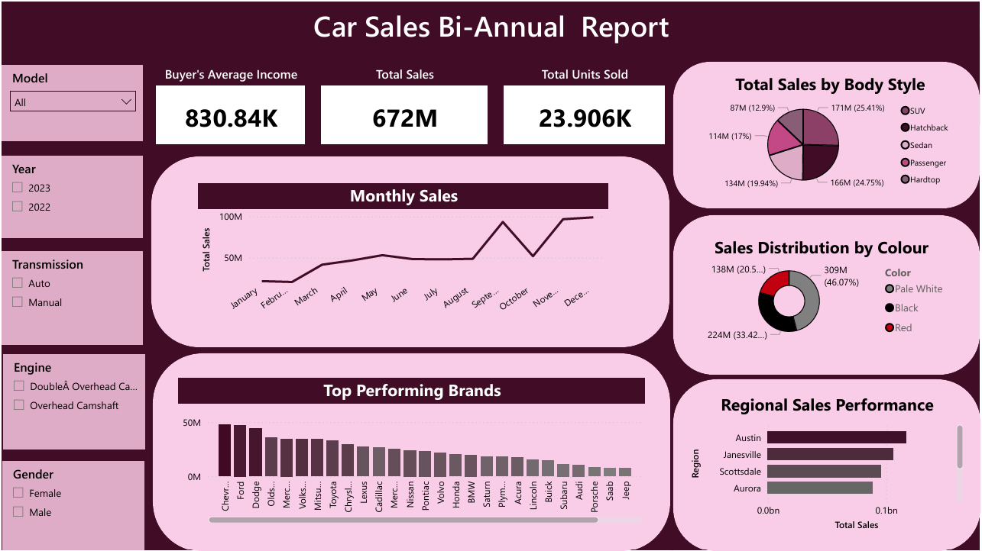

Slide 3
Executive Summary: Bi-Annual Car Sales Analysis
This report provides a comprehensive overview of sales performance, highlighting key metrics and market trends to inform strategic decision-making.
Key Performance Indicators:
The organization achieved a total sales volume of $672M.
The average annual income of our buyer demographic stands at $830,840
Market Insights:
Monthly sales data indicates a positive upward trajectory, with notable performance peaks observed in the final quarter.
Chevrolet, Ford, and Dodge currently lead as the top-performing brands in our portfolio.
Sales are robust across our key regions, with Austin and Janesville emerging as our top-performing markets.
Consumer interest is segmented across diverse body styles, with a strong market preference for specific vehicle colors, notably Black and Pale White.

Slide 4
Thank you.

